Slide 1
Klipper Defaults
Default I2C SDA=>PC1, SCL=>PC0
Default SPI SCK0=>PB7, MISI0=>PB6, MOSI0=>PB5, SS=>PB4
Default Serial RX=>PD0, TX=>PD1

Slide 2
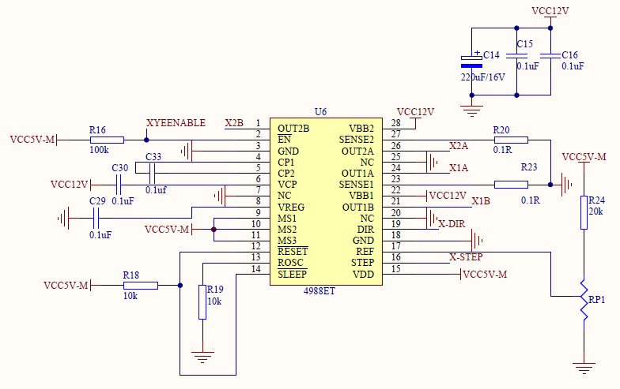
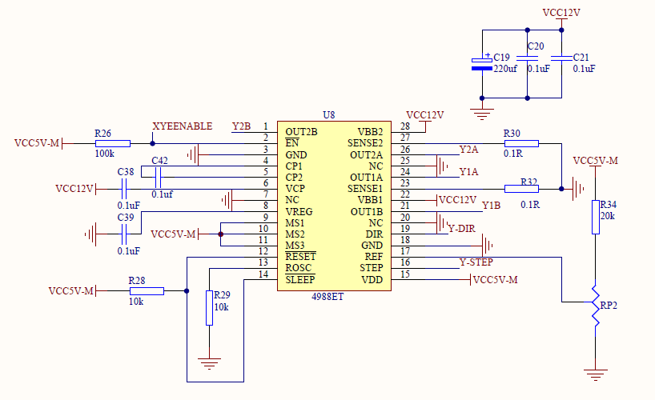
X_EN | PD6 / 14 | I/O | General Purpose I/O
 |  |  | ICP1 (Timer/Counter1 Input Capture Trigger)
 |  |  | OC2B (Timer/Counter2 Output Compare Match B Output)
 |  |  | PCINT30 (Pin Change Interrupt 30)
X_STEP | PD7 / 15 | I/O | General Purpose I/O
 |  |  | OC2A (Timer/Counter2 Output Compare Match A Output)
 |  |  | PCINT31 (Pin Change Interrupt 31)
X_DIR | PC5 / 21 | I/O | General Purpose I/O
 |  |  | TDI (JTAG Test Data Input)
 |  |  | PCINT21 (Pin Change Interrupt 21)
Y_EN | PD6 / 14 | I/O | General Purpose I/O
 |  |  | ICP1 (Timer/Counter1 Input Capture Trigger)
 |  |  | OC2B (Timer/Counter2 Output Compare Match B Output)
 |  |  | PCINT30 (Pin Change Interrupt 30)
Y_STEP | PC6 / 22 | I/O | General Purpose I/O
 |  |  | TOSC1 (Timer Oscillator pin 1)
 |  |  | PCINT22 (Pin Change Interrupt 22)
Y_DIR | PC7 / 23 | I/O | General Purpose I/O
 |  |  | TOSC2 (Timer Oscillator pin 2)
 |  |  | PCINT23 (Pin Change Interrupt 23)

Slide 3
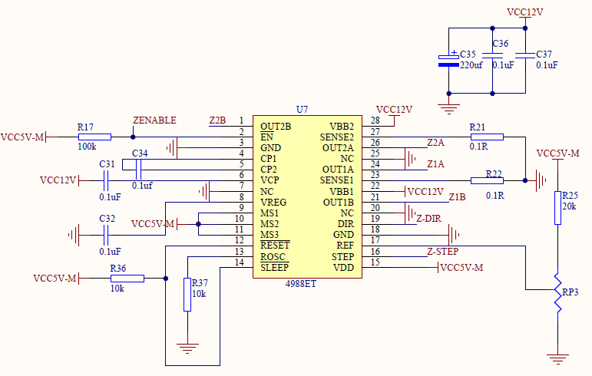
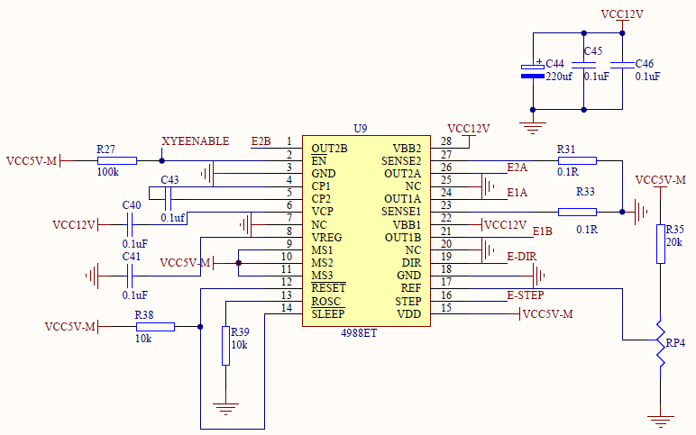
Z_EN | PA5 / 26 | I/O | General Purpose I/O
 |  |  | ADC5 (ADC input channel 5)
 |  |  | PCINT5 (Pin Change Interrupt 5)
Z_STEP | PB3 / 3 | I/O | General Purpose I/O
 |  |  | AIN1 (Analog Comparator Negative Input)
 |  |  | OC0A (Timer/Conter 0 Output Compare Match A Output)
 |  |  | PCINT11 (Pin Change Interrupt 11)
Z_DIR | PB2 / 2 | I/O | General Purpose I/O
 |  |  | AIN0 (Analog Comparator Positive Input)
 |  |  | INT2 (External Interrupt 2 Input)
 |  |  | PCINT10 (Pin Change Interrupt 10)
E0_EN | PD6 / 14 | I/O | General Purpose I/O
 |  |  | ICP1 (Timer/Counter1 Input Capture Trigger)
 |  |  | OC2B (Timer/Counter2 Output Compare Match B Output)
 |  |  | PCINT30 (Pin Change Interrupt 30)
E0_STEP | PB1 / 1 | I/O | General Purpose I/O
 |  |  | T1 (Timer/Counter 1 External Counter Input)
 |  |  | CLKO (Divided System Clock Output)
 |  |  | PCINT9 (Pin Change Interrupt 9)
E0_DIR | PB0 / 0 | I/O | General Purpose I/O
 |  |  | T0 (Timer/Counter 0 External Counter Input)
 |  |  | XCK0 (USART0 External Clock Input/Output)
 |  |  | PCINT8 (Pin Change Interrupt 8)

Slide 4
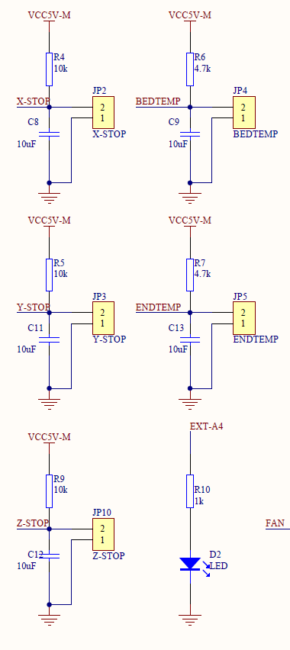
X_STOP | PC2 / 18 | I/O | General Purpose I/O
 |  |  | TCK (JTAG Test Clock)
 |  |  | PCINT18 (Pin Change Interrupt 18)
Y_STOP | PC3 / 19 | I/O | General Purpose I/O
 |  |  | TMS (JTAG Test Mode Select)
 |  |  | PCINT19 (Pin Change Interrupt 19)
Z_STOP | PC4 / 20 | I/O | General Purpose I/O
 |  |  | TDO (JTAG Test Data Output)
 |  |  | PCINT20 (Pin Change Interrupt 20)
BEDTEMP | PA6 / 25 | I/O | General Purpose I/O
 |  |  | ADC6 (ADC input channel 6)
 |  |  | PCINT6 (Pin Change Interrupt 6)
E0TEMP | PA7 / 24 | I/O | General Purpose I/O
 |  |  | ADC7 (ADC input channel 7)
 |  |  | PCINT7 (Pin Change Interrupt 7)
EXT_LED | PA4 / 27 | I/O | General Purpose I/O
 |  |  | ADC4 (ADC input channel 4)
 |  |  | PCINT4 (Pin Change Interrupt 4)

Slide 5
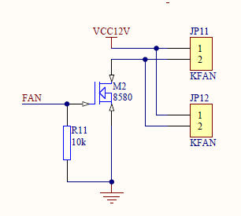
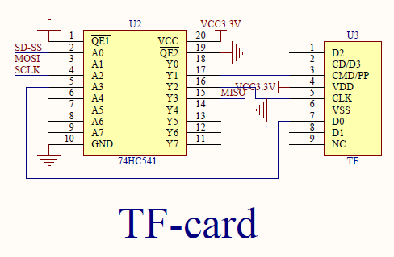
FAN | PB4 / 4 | I/O | General Purpose I/O
 |  |  | SS (SPI Slave Select input)
 |  |  | OC0B (Timer/Conter 0 Output Compare Match B Output)
 |  |  | PCINT12 (Pin Change Interrupt 12)
SD_DATA2 |  | I/O | General Purpose I/O
SD_MISO | PB6 / 6 | I/O | General Purpose I/O
 |  |  | MISO (SPI Bus Master Input/Slave Output)
 |  |  | OC3A (Timer/Conter 3 Output Compare Match A Output)
 |  |  | PCINT14 (Pin Change Interrupt 14)
SD_SCK | PB7 / 7 | I/O | General Purpose I/O
 |  |  | SCK (SPI Bus Master clock input)
 |  |  | OC3B (Timer/Conter 3 Output Compare Match B Output)
 |  |  | PCINT15 (Pin Change Interrupt 15)
SD_MOSI | PB5 / 5 | I/O | General Purpose I/O
 |  |  | MOSI (SPI Bus Master Output/Slave Input)
 |  |  | ICP3 (Timer/Counter3 Input Capture Trigger)
 |  |  | PCINT13 (Pin Change Interrupt 13)
SD_SSEL | PA0 /31 | I/O | General Purpose I/O
 |  |  | ADC0 (ADC input channel 0)
 |  |  | PCINT0 (Pin Change Interrupt 0)

Slide 6
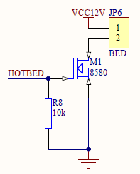
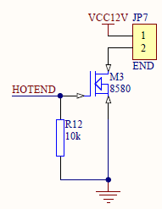
HOTBED | PD4 / 12 | I/O | General Purpose I/O
 |  |  | OC1B (Timer/Counter1 Output Compare Match B Output)
 |  |  | XCK1 (USART1 External Clock Input/Output)
 |  |  | PCINT28 (Pin Change Interrupt 28)
HOTEND | PD5 / 13 | I/O | General Purpose I/O
 |  |  | OC1A (Timer/Counter1 Output Compare Match A Output)
 |  |  | PCINT29 (Pin Change Interrupt 29)

Slide 7
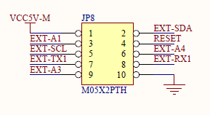
VCC
EXT_SDA / D_MOSI (LCD_ENABLE) | PC1 / 17 | I/O | General Purpose I/O
 |  |  | SDA (2-wire Serial Bus Data Input/Output Line)
 |  |  | PCINT17 (Pin Change Interrupt 17)
EXT_A1 / D_SCK (LCD_D4) | PA1 / 30 | I/O | General Purpose I/O
 |  |  | ADC1 (ADC input channel 1)
 |  |  | PCINT1 (Pin Change Interrupt 1)
RESET
EXT-SCL / BTN_CLICK (BTN_ENC) | PC0 / 16 | I/O | General Purpose I/O
 |  |  | SCL (2-wire Serial Bus Clock Line)
 |  |  | PCINT16 (Pin Change Interrupt 16)
EXT-A4 / BEEPER | PA4 / 27 | I/O | General Purpose I/O
 |  |  | ADC4 (ADC input channel 4)
 |  |  | PCINT4 (Pin Change Interrupt 4)
Ender 3 and CR-10 Stock Display Connector

Slide 8
EXT-TX1 / BTN_EN1 | PD3 / 11 | I/O | General Purpose I/O
 |  |  | INT1 (External Interrupt1 Input)
 |  |  | TXD1 (USART1 Transmit Pin)
 |  |  | PCINT27 (Pin Change Interrupt 27)
EXT-RX1 / BTN_EN2 | PD2 / 10 | I/O | General Purpose I/O
 |  |  | INT0 (External Interrupt0 Input)
 |  |  | RXD1 (USART1 Receive Pin)
 |  |  | PCINT26 (Pin Change Interrupt 26)
EXT-A3 / D_CS (LCD_RS) | PA3 / 28 | I/O | General Purpose I/O
 |  |  | ADC3 (ADC input channel 3)
 |  |  | PCINT3 (Pin Change Interrupt 3)
GND
Ender 3 and CR-10 Stock Display Connector

